Slide 1
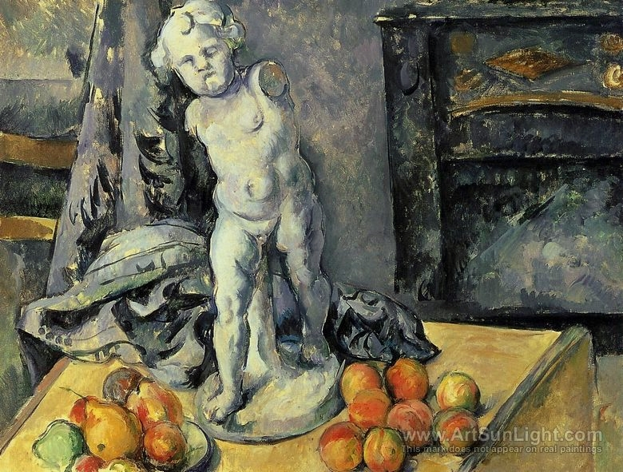
Paul Cézanne
(1839 – 1906)
France
History of Modern Art
BFA-III (Visual Arts)
Course Incharge: Ms. Sidra Liaqat
Institute of Design & Visual Arts, LCWU

Slide 2
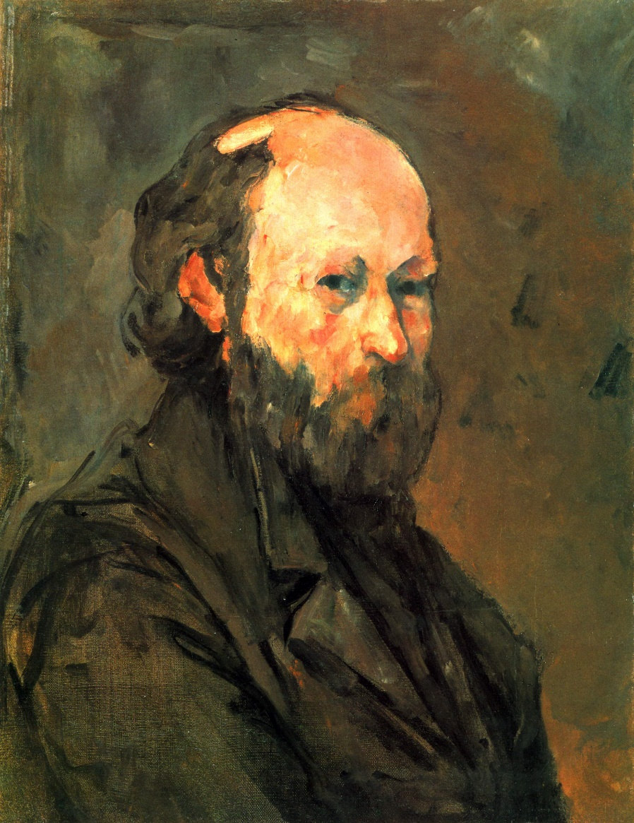
“Treat nature in terms of the cylinder, the sphere and the cone, everything in proper perspective …”
“I owe you the truth in painting.”
- Paul Cézanne

Slide 3
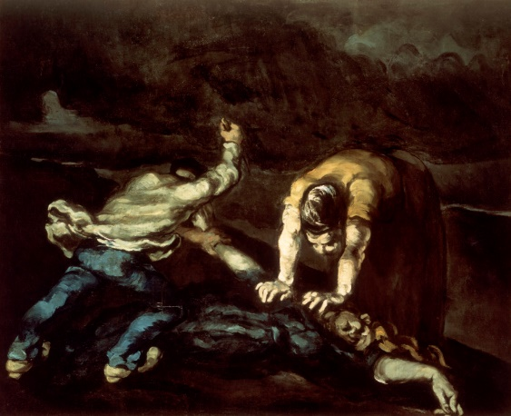
“The Murder”
(1870)

Slide 4
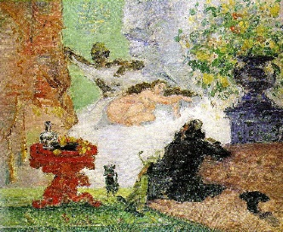
“A Modern Olympia” (1874)

Slide 5
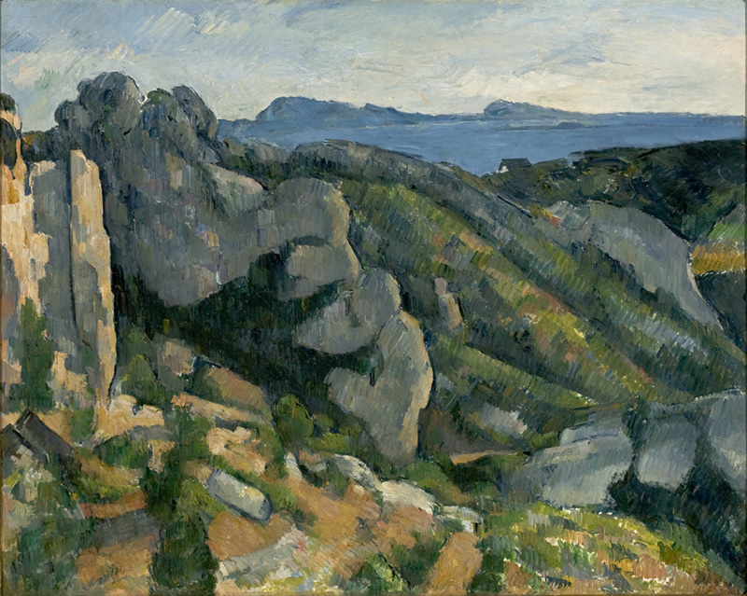
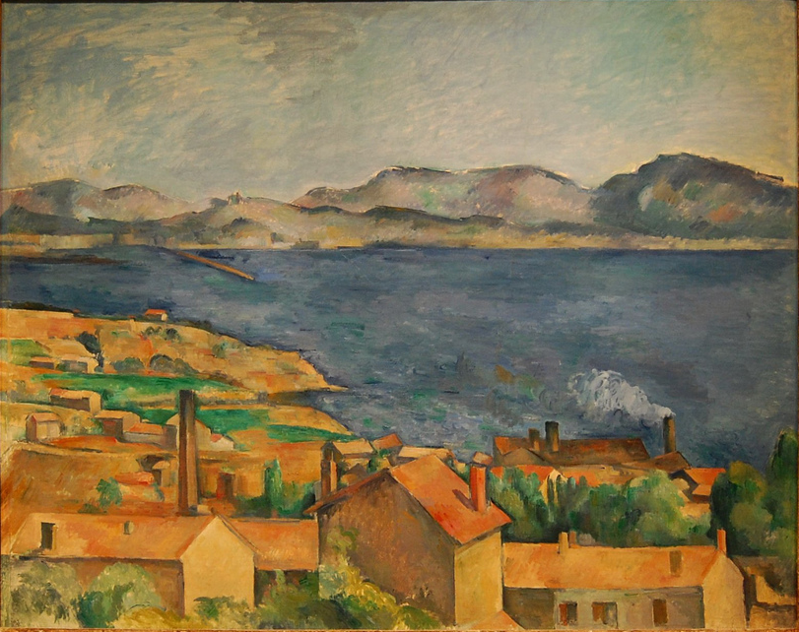
“Rocks at L’Estaque”
“The Bay of Marseilles”

Slide 6
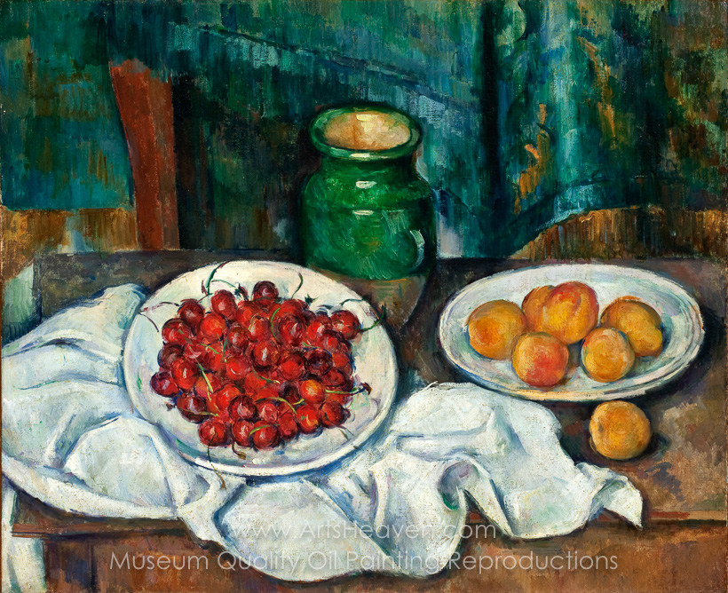
“Still Life with Plate of Cherries”
(1885)

Slide 7
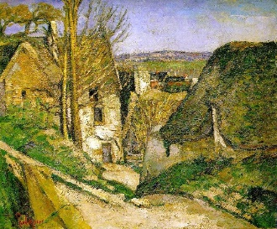
“The House of the Hanged Man” (1873)

Slide 8
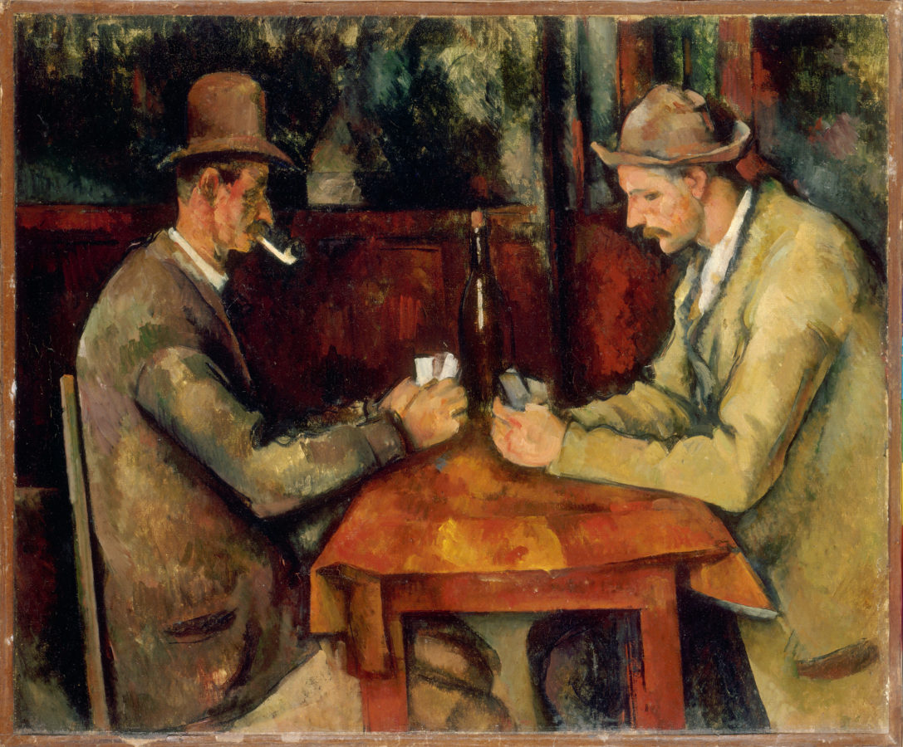
“The Card Players”
(1895)

Slide 9
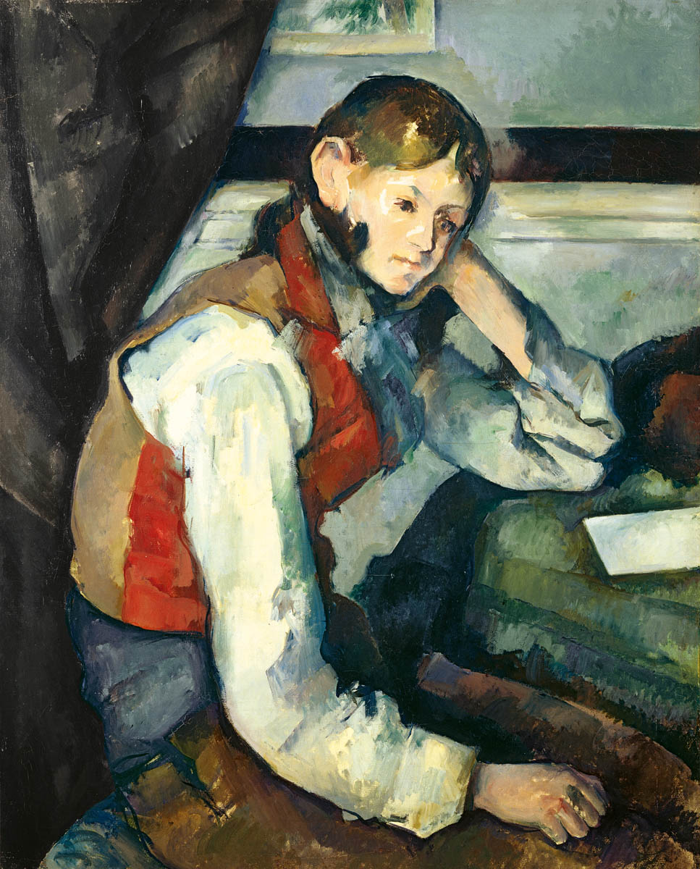
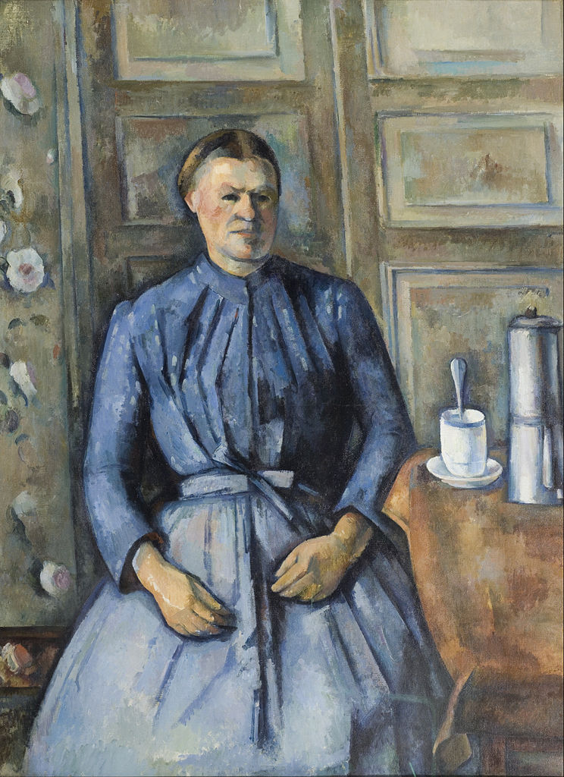
“Boy in a Red Waistcoat” (1895)
“Woman with the Coffee Pot” (1895)

Slide 10
“Still Life with Cupid”
(1895)

Slide 12
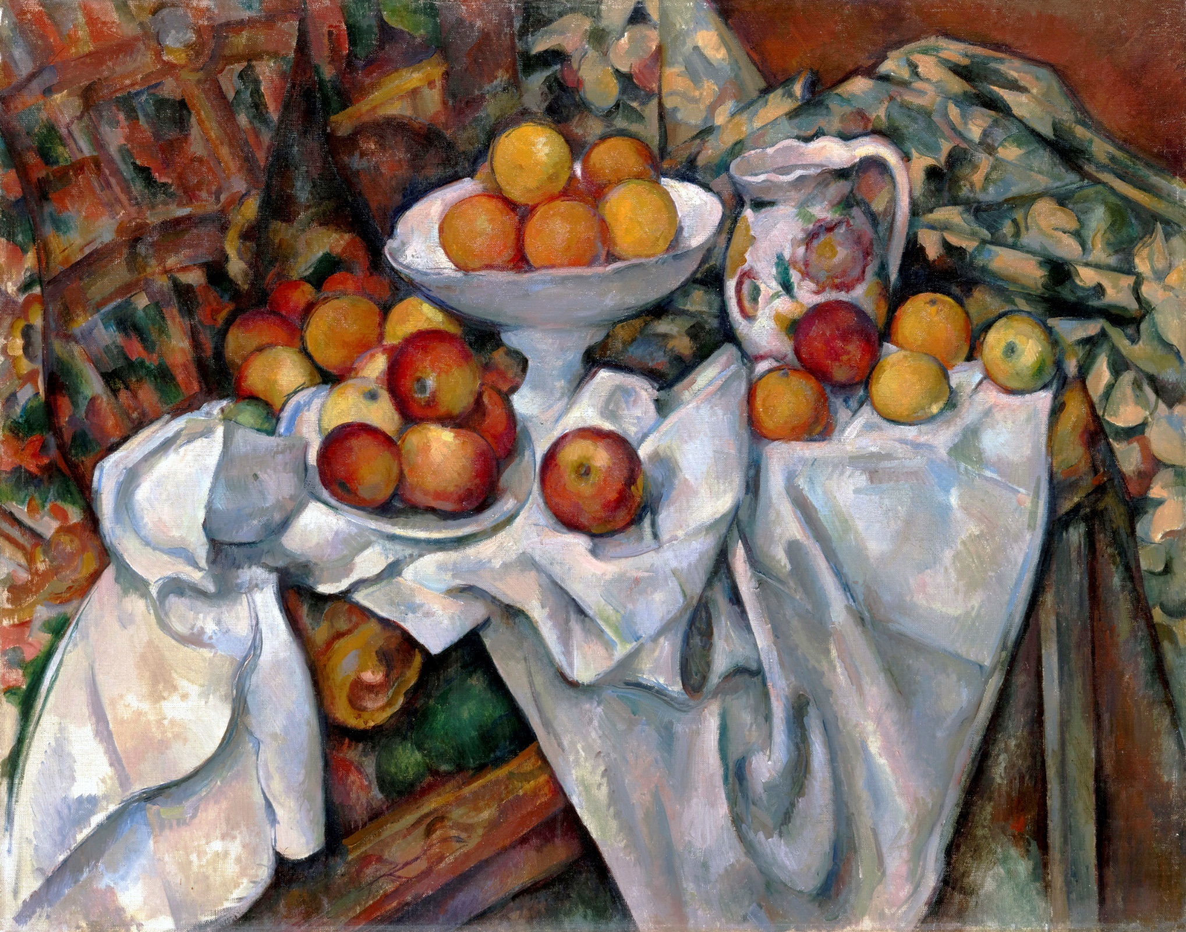
“Apples and Oranges”
(1900)

Slide 13
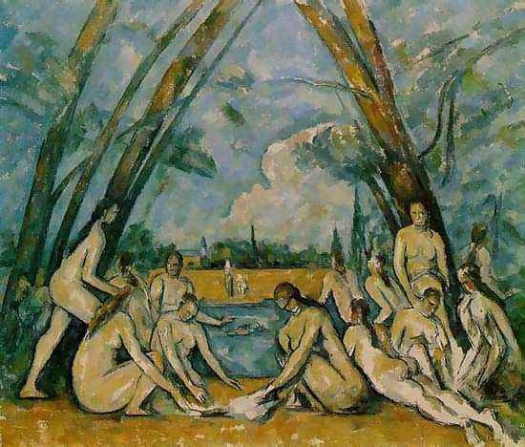
“Les Grande Baigneuses” /
“The Large Bathers”
(1898-1905)

Slide 14
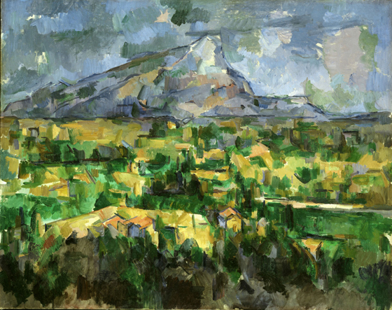
“Mont Saint-Victoire”
(1905)

Slide 15
